Slide 1
Splunk: Search, Statistics and Report
SIEMS Day 2

Slide 2
Class Objectives
By the end of class today, students will be able to:
Use SPL to create advanced searches.
Describe how pipes are used to chain together a series of SPL commands.
Use statistical methods such as frequencies, baselines, and thresholds.
Analyze events to develop baselines and thresholds.

Slide 3
Activity: Warm-Up Interview Quiz
In this activity, you will simulate answering questions in a technical interview about Splunk Enterprise.
Instructions sent via Slack.
15 Minutes

Slide 4
Interview Questions

Slide 5
Warm-Up Review
Execute the following searches and explain why you are conducting each investigation and what is returned in the search events.
1. host=quiz sourcetype=access_* AND (status=500 OR status=404)

Slide 6
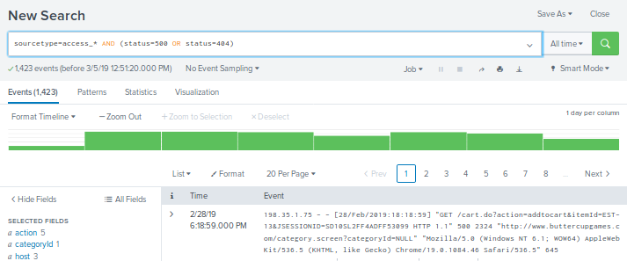
Warm-Up Review
Execute the following searches and explain why you are conducting each investigation and what is returned in the search events.
1. host=quiz sourcetype=access_* AND (status=500 OR status=404)
What: This search monitors for several internal errors or pages not found errors on all servers.
Why: To check website performance issues.

Slide 7
Warm-Up Review
Execute the following searches and explain why you are conducting each investigation and what is returned in the search events.
2. host=quiz source=*mailsv/secure.log failed password

Slide 8
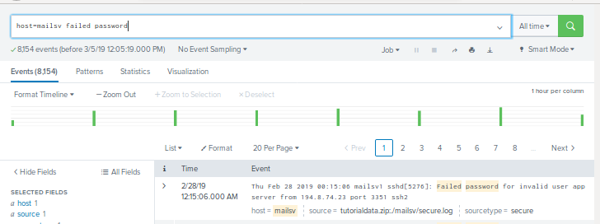
Warm-Up Review
Execute the following searches and explain why you are conducting each investigation and what is returned in the search events.
2. host=quiz source=*mailsv/secure.log failed password
What: This search looks for password attempts on the mail server host in secure.log file.
Why: To investigate possible password cracking.

Slide 9
Warm-Up Review
Execute the following searches and explain why you are conducting each investigation and what is returned in the search events.
3. host=quiz source=*www1* useragent=*
Notes:
This search can be used to analyze a request header. The User-agent Header contains the application type, operating system, software vendor or software version of the requesting software user agent. We are conducting the investigation on all www hosts.

Slide 10
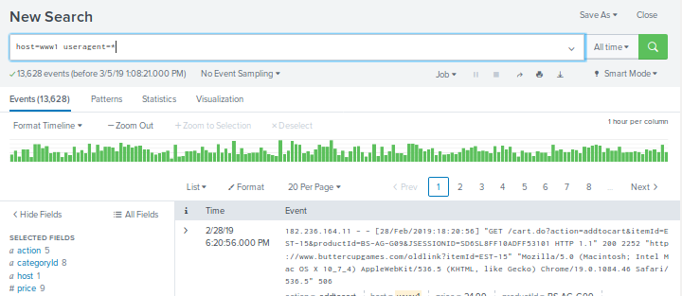
Warm-Up Review
Execute the following searches and explain why you are conducting each investigation and what is returned in the search events.
3. host=quiz source=*www1* useragent=*
What: This search can be used to analyze a request header.
Why: To track down specific information for requests made to the buttercupgames site.
Notes:
This search can be used to analyze a request header. The User-agent Header contains the application type, operating system, software vendor or software version of the requesting software user agent. We are conducting the investigation on all www hosts.

Slide 11
Warm-Up Review
Execute the following searches and explain why you are conducting each investigation and what is returned in the search events.
4. “?msg=Credit*” AND file=“error.do” AND source!=*www2*

Slide 12
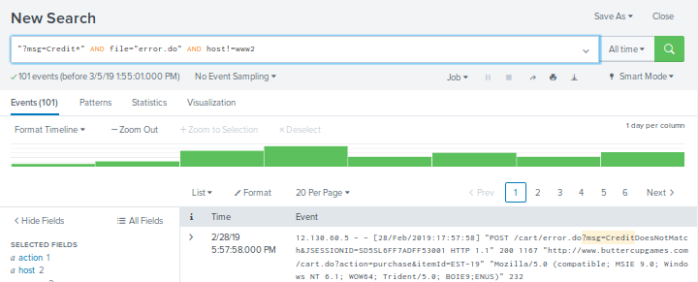
Warm-Up Review
Execute the following searches and explain why you are conducting each investigation and what is returned in the search events.
4. host=quiz “?msg=Credit*” AND file=“error.do” AND source!=*www2*
What:This search returns the purchase date, purchase item ID, user agent and client IP address for transactions on all hosts except www2.
Why:To Investigate possible credit card fraud.

Slide 13
Using the SPL Search Pipeline

Slide 14
We have already used the Pipe Operator “|” to send the standard output of one command to the standard input of another command.

Slide 15
Unix Review: Pipes and Pipelines
What do each of these commands do?
$ ps -aux | wc -l
$ ls var/log/*.log | grep conf | wc -l

Slide 16
Unix Review: Pipes and Pipelines
What do each of these commands do?
$ ps -aux | wc -l
This command displays the number of processes running in the system.
$ ls var/log/*.log | grep conf | wc -l

Slide 17
Unix Review: Pipes and Pipelines
What do each of these commands do?
$ ps -aux | wc -l
This command displays the number of processes running in the system.
$ ls var/log/*.log | grep conf | wc -l
This command gets the list of files in the var/log directory with the *.log extension.
The output from the ls command is passed to the grep command to look for the string conf.
The output from the grep command is passed to the wc command to count the number of lines.

Slide 18
How do Pipes and Pipelines Work?
Pipes are used in Search Process Learning (SPL) to narrow down search result to specific criteria:
Like Unix, a vertical bar “ | ” is used to chain together a series (or pipeline) of search commands.
Commands are processed from left to right.
The results of the command to the left of the | operator is fed into the command to the right of the | operator.
The intermediate command results table from each search is used (or piped) as input to the next command.

Slide 19
How Do Pipes and Pipelines Work?
source=access_30DAY.log status=500 | top limit=5 useragent
1
AND
2
3
Final Results
search
source=access_30Day.log status = 500
Top limit= 5 useragent
fields - percent
131,645 events
2,044 events
1,185 events
1,185 events
useragent | count | percent
Mozilla/5 | 478 | 23.355
Mozilla/5 | 192 | 9.393
Mozilla/5 | 176 | 8.010
Mozilla/5 | 173 | 4.403
Mozilla/5 | 166 | 8.121
useragent | count
Mozilla/5 | 478
Mozilla/5 | 192
Mozilla/5 | 176
Mozilla/5 | 173
Mozilla/5 | 166
……….
……….
……….
……….
……….
……….

Slide 20
Traveling down the Pipeline
source=access_30Day.log
status=500 (status field)
top limit= 5 useragent (The first pipe)
fields - percent (The second pipe)

Slide 21
Activity: Using Pipes in Splunk
In this activity, you will use the Splunk search pipeline and alert logs from the SNORT IDS.
Instructions sent via Slack.
20 Minutes

Slide 22
Using Pipes in Splunk

Slide 23
Using Pipes in Splunk Review
Part 1: Create a search that will find all alerts for port scanning activity. Display results for the top destination IP addresses.

Slide 24
Using Pipes in Splunk Review
Part 1: Create a search that will find all alerts for port scanning activity. Display results for the top destination IP addresses.
Search command:
source=“alert_json_000015.log” | top dst_ap

Slide 25
Using Pipes in Splunk Review
Part 1: Create a search that will find all alerts for port scanning activity. Display results for the top destination IP addresses.
Search command:
source=“alert_json_000015.log” | top dst_ap
How many search results were returned from the top command?

Slide 26
Using Pipes in Splunk Review
Part 1: Create a search that will find all alerts for port scanning activity. Display results for the top destination IP addresses.
Search command:
source=“alert_json_000015.log” | top dst_ap
How many search results were returned from the top command?
The top command returns the first 10 search results by default.

Slide 27
Using Pipes in Splunk Review
Part 1: Create a search that will find all alerts for port scanning activity. Display results for the top destination IP addresses.
Search command:
source=“alert_json_000015.log” | top dst_ap
How many search results were returned from the top command?
The top command returns the first 10 search results by default.
Look at the Interesting Fields down on the protocol. What were the top three scans that were performed?

Slide 28
Using Pipes in Splunk Review
Part 1: Create a search that will find all alerts for port scanning activity. Display results for the top destination IP addresses.
Search command:
source=“alert_json_000015.log” | top dst_ap
How many search results were returned from the top command?
The top command returns the first 10 search results by default.
Look at the Interesting Fields down on the protocol. What were the top three scans that were performed?
ICMP
TCP
ARP

Slide 29
Using Pipes in Splunk Review
Part 1: Create a search that will find all alerts for port scanning activity. Display results for the top destination IP addresses.
Narrow the search to contain only the TCP port scans for the top five source IP addresses. Show only the number of search results
This search command uses the logical AND operator and two pipes.

Slide 30
Using Pipes in Splunk Review
Part 1: Create a search that will find all alerts for port scanning activity. Display results for the top destination IP addresses.
Narrow the search to contain only the TCP port scans for the top five source IP addresses. Show only the number of search results
This search command uses the logical AND operator and two pipes.
source="alert_json_000015.log” AND proto="TCP" | top limit=5 src_ap | fields - percent

Slide 31
Using Pipes in Splunk Review
Part 2: Create a search that lists the destination AP in decending order

Slide 32
Using Pipes in Splunk Review
Part 2: Create a search that lists the destination AP in decending order
source=“alert_json_000015.log” | sort -dst_ap

Slide 33
Using Pipes in Splunk Review
Answer the Questions / Fill in the Blanks
1. Limiting search by _______ is key to faster results and is a best practice.
2. What are the three main search modes?
3. _______ mode has discovery OFF for event searches. No event or field data for stats searches.
4. _______ mode has all events and field data; switches to this mode after visualization.

Slide 34
Using Pipes in Splunk Review
Part 3: Answer the Questions / Fill in the Blanks
1. Limiting search by _______ is key to faster results and is a best practice.
Time
2. What are the three main search modes?
3. _______ mode has discovery OFF for event searches. No event or field data for stats searches.
4. _______ mode has all events and field data; switches to this mode after visualization.

Slide 35
Using Pipes in Splunk Review
Answer the Questions / Fill in the Blanks
1. Limiting search by _______ is key to faster results and is a best practice.
Time
2. What are the three main search modes?
Fast, Verbose, and Smart
3. _______ mode has discovery OFF for event searches. No event or field data for stats searches.
4. _______ mode has all events and field data; switches to this mode after visualization.

Slide 36
Using Pipes in Splunk Review
Answer the Questions / Fill in the Blanks
1. Limiting search by _______ is key to faster results and is a best practice.
Time
2. What are the three main search modes?
Fast, Verbose, and Smart
3. _______ mode has discovery OFF for event searches. No event or field data for stats searches.
Fast
4. _______ mode has all events and field data; switches to this mode after visualization.

Slide 37
Using Pipes in Splunk Review
Answer the Questions / Fill in the Blanks
1. Limiting search by _______ is key to faster results and is a best practice
Time
2. What are the three main search modes?
Fast, Verbose, and Smart
3. _______ mode has discovery OFF for event searches. No event or field data for stats searches.
Fast
4. _______ mode has all events and field data; switches to this mode after visualization.
Verbose

Slide 38
Using Pipes in Splunk Review
Answer the Questions / Fill in the Blanks
5. _______ mode (default-based on search string data) has field discovery ON for event searches. No event or field data for stats searches.
6. List the three booleans operators.
7. When searching for exact phrases you need to use ________
8. ________ fields that appear by default are host, sourcetype, source
9. Having only the choices of inclusion and exclusion, which is preferable?

Slide 39
Using Pipes in Splunk Review
Answer the Questions / Fill in the Blanks
5. _______ mode (default-based on search string data) has field discovery ON for event searches. No event or field data for stats searches.
Smart
6. List the three booleans operators.
7. When searching for exact phrases you need to use ________
8. ________ fields that appear by default are host, sourcetype, source
9. Having only the choices of inclusion and exclusion, which is preferable?

Slide 40
Using Pipes in Splunk Review
Answer the Questions / Fill in the Blanks
5. _______ mode (default-based on search string data) has field discovery ON for event searches. No event or field data for stats searches.
Smart
6. List the three booleans operators.
NOT, AND, OR
7. When searching for exact phrases you need to use ________
8. ________ fields that appear by default are host, sourcetype, source
9. Having only the choices of inclusion and exclusion, which is preferable?

Slide 41
Using Pipes in Splunk Review
Answer the Questions / Fill in the Blanks
5. _______ mode (default-based on search string data) has field discovery ON for event searches. No event or field data for stats searches.
Smart
6. List the three booleans operators.
NOT, AND, OR
7. When searching for exact phrases you need to use ________
Quotations
8. ________ fields that appear by default are host, sourcetype, source
9. Having only the choices of inclusion and exclusion, which is preferable?

Slide 42
Using Pipes in Splunk Review
Answer the Questions / Fill in the Blanks
5. _______ mode (default-based on search string data) has field discovery ON for event searches. No event or field data for stats searches.
Smart
6. List the three booleans operators.
NOT, AND, OR
7. When searching for exact phrases you need to use ________
Quotations
8. ________ fields that appear by default are host, sourcetype, source.
Selected Fields
9. Having only the choices of inclusion and exclusion, which is preferable?

Slide 43
Using Pipes in Splunk Review
Answer the Questions / Fill in the Blanks
5. _______ mode (default-based on search string data) has field discovery ON for event searches. No event or field data for stats searches.
Smart
6. List the three booleans
NOT, AND, OR
7. When searching for exact phrases you need to use ________
Quotations
8. ________ fields that appear by default are host, sourcetype, source.
Selected Fields
9. Having only the choices of inclusion and exclusion, which is preferable?
Exclusion is better than inclusion

Slide 45
Using Tables to Display Events in Splunk

Slide 46
Now, we will continue to use pipelines and demo how to use the table command to return a table with specified fields.

Slide 47
Using Tables to Display Events in Splunk
Next, we will use the table command to return a table with specified fields.
By default, the columns in a table are labeled using the field name, but this may not always be the most useful labeling method.
For example: The count field can mean different things in different searches: count of errors? count of purchases?
Labeled Tables simplifies the process of interpreting results of searches in reports and dashboards.

Slide 48
How to Create Tables

Slide 49
Using Tables to Display Events in Splunk
The Table Command
source="alert_json_000015.log" proto="UDP" src_ap="192*" dst_ap="192*" | table proto, src_ap, dst_ap, | rename proto AS "Protocol" src_ap AS "Source IP and Port" dst_ap AS Destination IP and Port"
The table command is preceded by a pipe “|” character.
The rename command is used to create the labels for the columns.
It is preceded by a pipe character.
Columns are displayed in the same order that fields are specified.
The first AS statement sets the proto field to display the text Prototype in the column header.
The next AS statements set the scr_ap and dst_ap fields display the text Source IP and Port and Destination IP and Port.

Slide 50
Activity: Using Tables in Splunk
In this activity, you will create a search that uses a table and removes duplicates.
Instructions sent via Slack.
10 Minutes

Slide 51
Using Tables in Splunk

Slide 52
Using Tables in Splunk Review
Create a search that returns events for Snort rules starting with 122.
Remove any duplicate source or destination IPs.
Create a table with the following fields: protocol, rule, source and destination aps.
Label the columns: Protocol, Rule, Source IP and Port and Destination IP and Port.

Slide 53
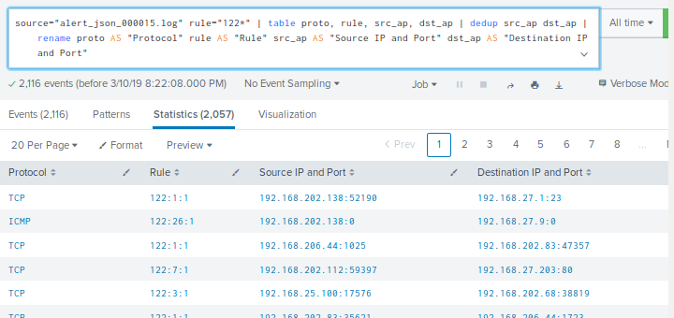
Using Tables in Splunk Review
Create a search that returns events for Snort rules starting with 122.
Search command:
source="alert_json_000015.log" rule="122*" | table proto, rule, src_ap, dst_ap | dedup src_ap dst_ap |rename proto AS "Protocol" rule AS "Rule" src_ap AS "Source IP and Port" dst_ap AS "Destination IP and Port"

Slide 54
Alerts in Splunk

Slide 55



Understanding the Splunk Alert
Remember from last class: Monitoring and alerting is a key component in Splunk
Alerts are used to monitor for and respond to specific events
Alerts can look for events in real time or on a schedule.
Alert can be assigned a priority, such as Information or Critical.

Slide 56
Parts of a Splunk Alert
Splunk alerts have a structure that defines how alerts are configured and handled:
alert-type triggering-options throttling-options
Alert Type: In Splunk, there are two alert types: scheduled and real-time.
The alert type determines when events are searched
Timing options or cron syntax can be used.
Triggering Option specifies how and the number of times an alert is triggered.
Dependent on the alert type.
Throttling Options specifies the time period of suppression.
Dependent on the alert type.

Slide 57
Real-Time Alerts
Real-time alerts monitor events continuously and can be configured to trigger once per-result or within a rolling time window.
Example 1: Trigger an alert every time there is a password failure on the root account.
The triggering options are set to alert every time there is a search result, a.k.a per-result triggering.
A custom script is run to alert the security team.
Example 2: Triggering an alert if a service has more than three errors in a minute.
Configure a real-time alert that searches for the service error event with a specified one minute rolling window.
An email is sent to the operations team.

Slide 58
Scheduled Alerts
Scheduled alerts, as it sounds, search for events a repeated schedule.
Example : Monitoring how often a server returns a 500 error.
Create a scheduled alert that searched for 500 errors every half hour and triggers an event when there are more than 50 results.
A Notification is logged to the TRiggered alerts list.
It is important to schedule a time range that prevents data from being evaluated twice in a search.
Events should be scheduled with a minimum of a one-minute delay.

Slide 59
Creating a Real-Time Alert

Slide 60
Activity: Using Alerts to Monitor System Files
In this activity, you will create an alert that will be logged in the Triggered Alert list.
Instructions sent via Slack.
10 Minutes

Slide 61
Using Alerts to Monitor System Files

Slide 62
Baselining

Slide 63
Using Baselines to Create Effective Alerts
You are tasked with monitoring a web application where customers can purchase your company’s products. You are concerned that there is a threat of an attacker attempting to brute force log in to your application.
How can we use Splunk so that we are aware if a brute force attack is occuring?
Why isn’t it ideal for an alert to triggered every time there are several failed attempts.

Slide 64
Using Baselines to Create Effective Alerts
You are tasked with monitoring a web application where customers can purchase your company’s products. You are concerned that there is a threat of an attacker attempting to brute force log in to your application.
How can we use Splunk so that we are aware if a brute force attack is occuring?
Create an alert.
Why isn’t it ideal for an alert to triggered every time there are several failed attempts?

Slide 65
Using Baselines to Create Effective Alerts
You are tasked with monitoring a web application where customers can purchase your company’s products. You are concerned that there is a threat of an attacker attempting to brute force log in to your application.
How can we use Splunk so that we are aware if a brute force attack is occuring?
Create an alert.
Why isn’t it ideal for an alert to triggered every time there are several failed attempts?
Customs may have forgotten their passwords, and have tried to log-in several ties. This is known as a false positive.

Slide 66
Baselining is the process of analyzing historical data in order to establish a metric of normal activity.

Slide 67
Setting a Baseline threshold
After analyzing historical data to establish a normal volume of activity, we need to establish an abnormal volume threshold that will trigger an alert if crossed.
Setting the threshold too high
will risk missing an alert.
Setting the threshold too low
will create too many false positives.

Slide 68
Baselining Demo
We’ll create a baseline demo on a sample Windows event log.
Load the event logs file.
Run a search.
View the search results.
Change Search criteria to look at failed logins.
Identify the spike in locked users.
Identify the baseline of normal activity.
Determine a threshold for an alert.

Slide 69

The preceding demo was only a 15 minute snippet of a Windows event log during a brute force attack.
Realistically, we would need to look at a much larger set of historical data in order to acquire an accurate baseline.

Slide 70
Student Activity: Alert Fatigue
In this activity, you will read an article on a major security concern called alert fatigue and then answer the provided questions.
Instructions sent via Slack.
10 Minutes

Slide 71
Alert Fatigue

Slide 72
Alert Fatigue Review
1. Define alert fatigue.
2. Identify one concerning takeaway from this article.

Slide 73
Alert Fatigue Review
1. Define alert fatigue.
Alert fatigue occurs when one is exposed to such a large number of frequent alerts that they become desensitized to them.
2. Identify one concerning takeaway from this article.

Slide 74
Alert Fatigue Review
1. Define alert fatigue.
Alert fatigue occurs when one is exposed to such a large number of frequent alerts that they become desensitized to them.
2. Identify one concerning takeaway from this article.
There are many takeaways from this article. Arguably, the biggest is that 31.9% of security professionals ignore alerts because there are too many false positives.

Slide 75
Alert Fatigue Review
3. Which organization was affected by alert fatigue? What happened?
4. How can a company prevent alert fatigue?

Slide 76
Alert Fatigue Review
3. Which organization was affected by alert fatigue? What happened?
Target was affected by alert fatigue in a 2014 breach. The security product they were using correctly alerted them of the breach. However, due to high volume of alerts and the frequency of false alerts, Target’s IT security team ignored it.
4. How can a company prevent alert fatigue?

Slide 77
Alert Fatigue Review
3. Which organization was affected by alert fatigue? What happened?
Target was affected by alert fatigue in a 2014 breach. The security product they were using correctly alerted them of the breach. However, due to high volume of alerts and the frequency of false alerts, Target’s IT security team ignored it.
4. How can a company prevent alert fatigue?
Create better alerts that have fewer false positives.
Create less alerts.
Create alerts that have severity indicators, such as Critical / High.

Slide 78
Class Objectives
By the end of class today, students will be able to:
Use SPL to create advanced searches.
Describe how pipes are used to chain together a series of SPL commands.
Use statistical methods such as frequencies , baselines, and thresholds.
Analyze events to develop baselines and thresholds.

